Slide 1

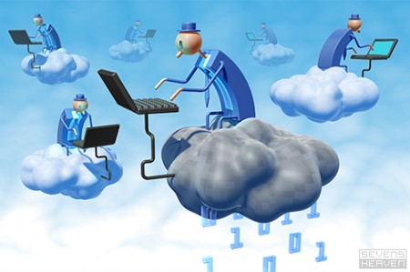
“In the Cloud”
Security and Reliability

Slide 2

Afnan Pathan
Anuj Khasgiwala
Computer Science Engineering
Medi-Caps Institute of Technology and Management, Indore.
“In the Cloud”

Slide 3
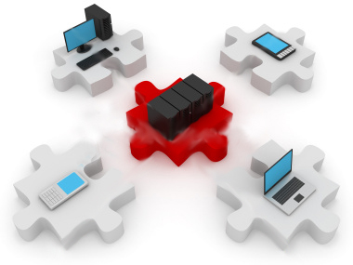
Introduction
Cloud computing providing unlimited infrastructure to store and execute customer data and program. As customers you do not need to own the infrastructure, they are merely accessing or renting, they can forego capital expenditure and consume resources as a service, paying instead for what they use.
“In the Cloud”

Slide 4
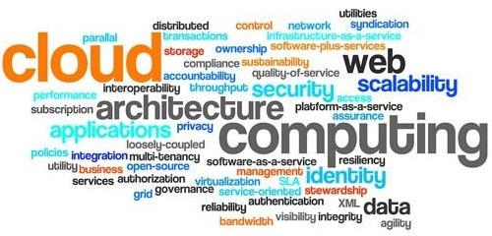
Benefits of Cloud Computing
Minimized Capital expenditure
Location and Device independence
Utilization and efficiency improvement
Very high Scalability
High Computing power
“In the Cloud”

Slide 5
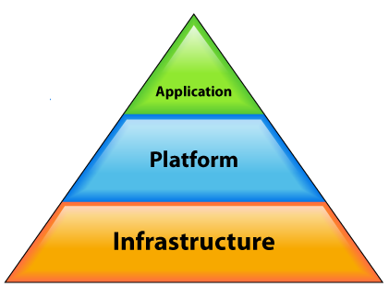

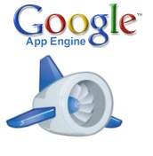
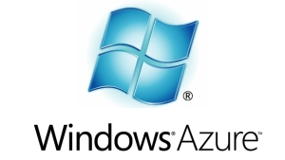


End Customers Developers System Admins
“In the Cloud”

Slide 6

Purpose
Security concerns arising because both customer data and program are residing in Provider Premises.
Security is always a major concern in Open System Architectures
“In the Cloud”

Slide 7
Dangers
Disrupts Services.
Theft of Information.
Loss of Privacy.
Damage information.
Vulnerabilities
Hostile Program.
Hostile people giving instructions to good programs.
Bad guys corrupting or eavesdropping on communications

Slide 8
Scope
Common Security and Reliability Requirements
Confidentiality
Integrity
Availability
Notes:
Confidentiality:
Ensuring that information is not disclosed to unauthorized person.
Integrity:
Ensure that information hold by system is proper representation of information intended and has not been modified by unauthorized person.
Availability:
Ensuring that information processing resources are not made unavailable by malicious actions.

Slide 9
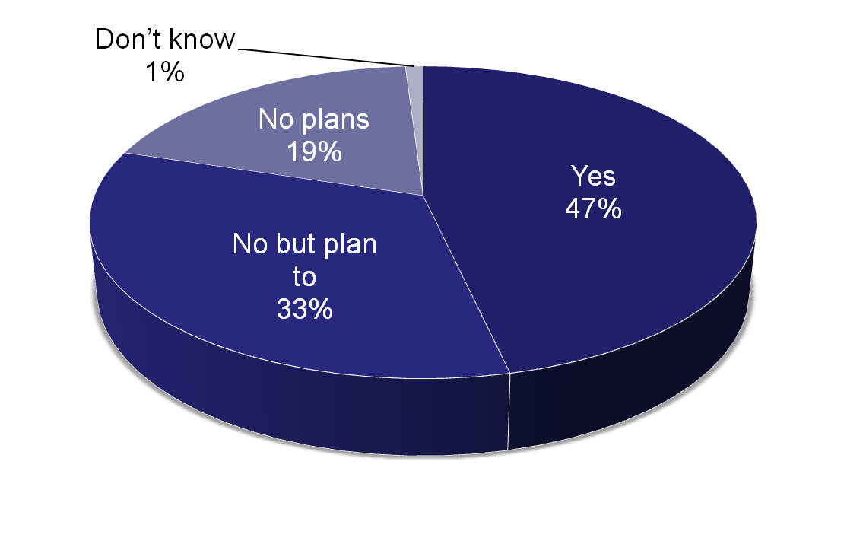
Reality
Organizations running applications in production on virtual infrastructure:
Enterprise Strategy Group, 2010 (N = 365 companies)

Slide 10
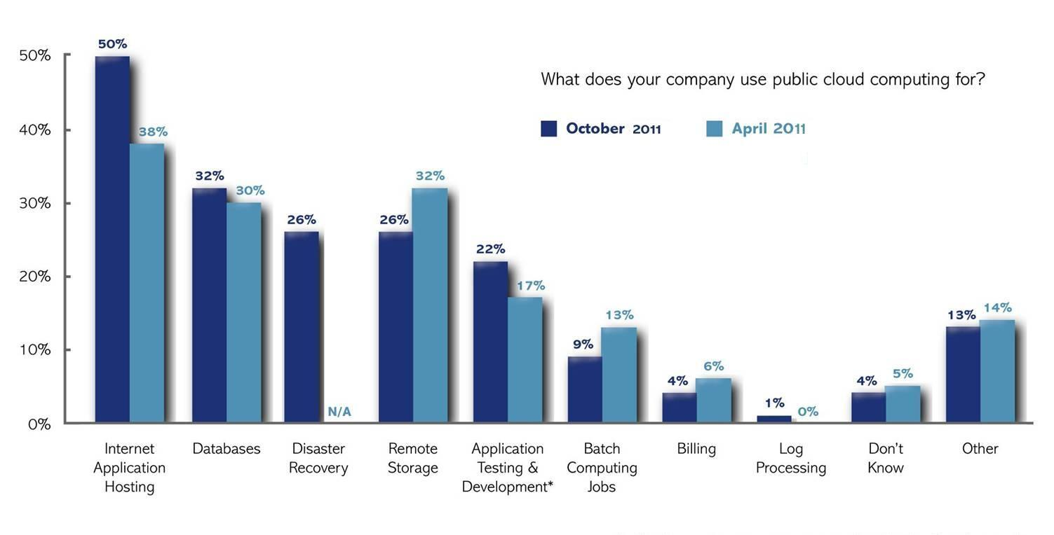
“In the Cloud”

Slide 11
Tools to be used
CloudSim: simulation framework that enables modeling, simulation, and experimentation of emerging Cloud computing infrastructures.
Eucalyptus: software platform for the implementation of private cloud computing on computer clusters .
Windows: preferred OS.
IBM WebSphere Application Server (WAS): application server.
IBM HTTP Server: web server.
“In the Cloud”
Notes:
CloudSim goal is to provide a generalized and extensible simulation framework that enables modeling, simulation, and experimentation of emerging Cloud computing infrastructures and application services, allowing its users to focus on specific system design issues that they want to investigate, without getting concerned about the low level details related to Cloud-based infrastructures and services.
support for modeling and simulation of large scale Cloud computing data centers
support for modeling and simulation of virtualized server hosts, with customizable policies for provisioning host resources to virtual machines
support for modeling and simulation of energy-aware computational resources
support for modeling and simulation of federated clouds
support for dynamic insertion of simulation elements, stop and resume of simulation
Eucalyptus is a software platform for the implementation of private cloud computing on computer clusters. There is an open-core enterprise edition and an open-source edition.
Eucalyptus implements IaaS (Infrastructure as a Service) style private and hybrid clouds.

Slide 12
Technologies to be used
Java
“In the Cloud”

Slide 13
Issue
Security Issues
Cloud Providers
Customers
“In the Cloud”

Slide 14
References:
Cloud Security
[en.wikipedia.org/wiki/Cloud_computing_security]
[www.eucalyptus.com]
[www.cloudbus.org/cloudsim/]

Slide 15
Queries

Slide 16
Thank You
“In the Cloud”

